Slide 1

Macroeconomics
Sixth Canadian Edition
Chapter 3
Business Cycle Measurement
Copyright © 2021 Pearson Canada Inc.
Notes:
If this PowerPoint presentation contains mathematical equations, you may need to check that your computer has the following installed:
1) MathType Plugin
2) Math Player (free versions available)
3) NVDA Reader (free versions available)

Slide 2
Chapter 3 Topics
Regularities in GDP fluctuations.
Co-movement
Behavior of Key Macroeconomic Variables.

Slide 3
Regularities in GDP Fluctuations
Business Cycles are fluctuations about trend in real GDP.
The turning points in the deviations of real GDP from trend are peaks and troughs.
Persistent positive deviations from trend are booms and persistent negative deviations from trend are recessions.
The fluctuations in GDP about trend can be choppy and irregular
There I no regularity in the:
Amplitude of;
Frequency of fluctuations in real GDP about trend

Slide 4
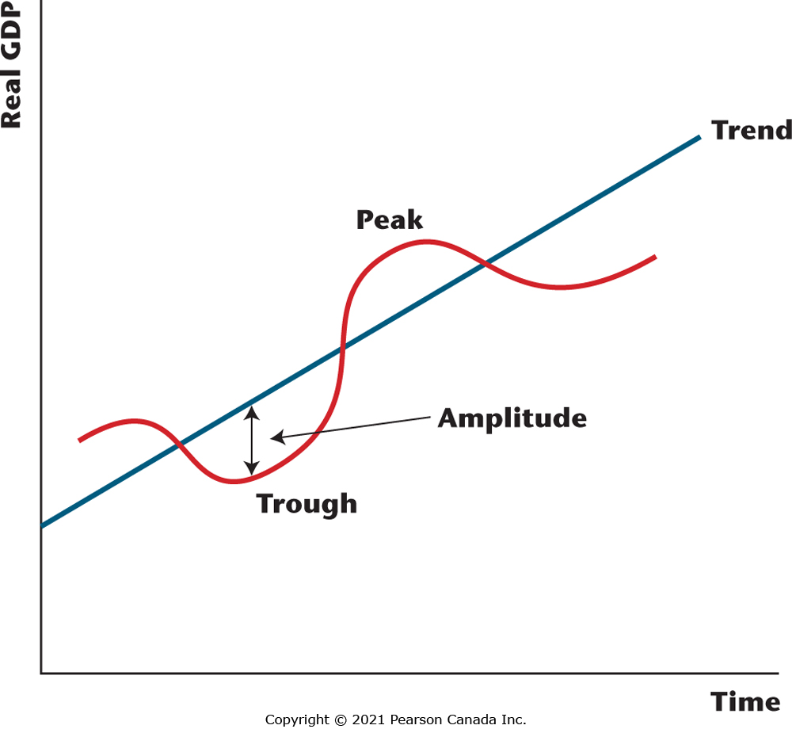
Figure 3.1 Idealized Business Cycles
The red curve is an idealized path for real GDP over time, while the blue line is the growth trend in real GDP. Note that real GDP cycles around the trend over time, with the maximum negative deviation from trend being a trough and the maximum positive deviation from trend being a peak. The amplitude is the size of the maximum deviation from trend, and the frequency is the number of peaks that occur within a year’s time.

Slide 5
Deviations From Trend in Real GDP are Irregular
The fluctuations in GDP about trend are quite choppy.
There is no regularity in the amplitude of fluctuations in real GDP about trend.
There is no regularity in the frequency of fluctuations in real GDP about trend.

Slide 6
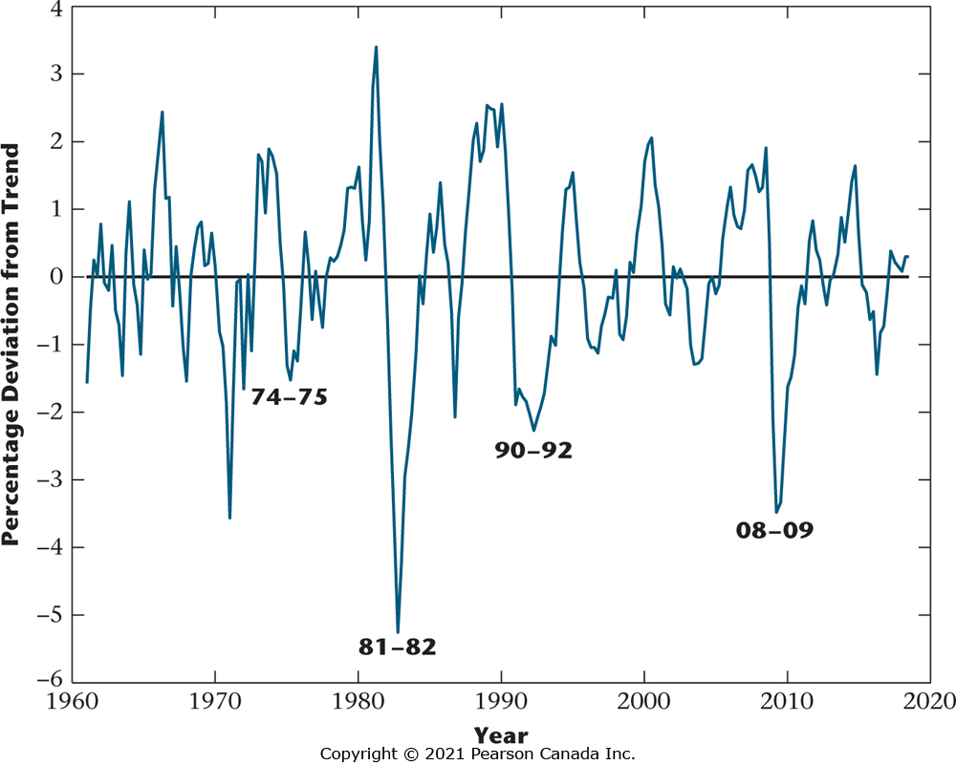
Figure 3.2 Percentage Deviations from Trend in Real GDP, 1961-2018
Of particular note are the four most recent recessions, in 1974–1975, 1981–1982, 1990–1992, and 2008–2009.

Slide 7
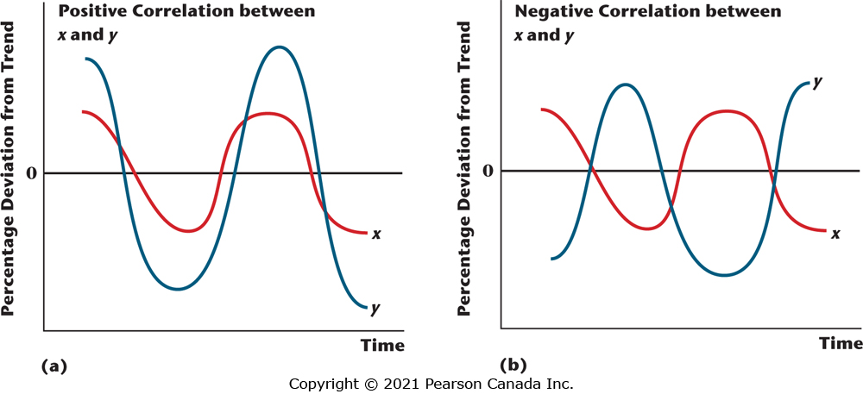
Figure 3.3 Time Series Plots of x and y
(a) Two time series that are positively correlated: when x is high (low), y tends to be high (low). (b) Two time series that are negatively correlated: when x is high (low), y tends to be low (high).

Slide 8
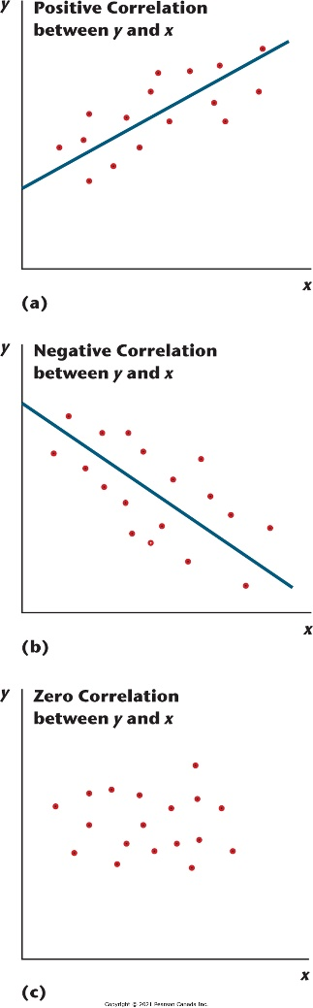
Figure 3.4 Scatter Plots of y and x
(a) x and y are positively correlated. (b) x and y are negatively correlated. (c) x and y are uncorrelated.

Slide 9
Correlation with Real GDP
If the deviations from trend in a macroeconomic variable are positively (negatively) correlated with the deviations from trend in real GDP, then that variable is procyclical (countercyclical).
If a macroeconomic variable is neither procyclical nor countercyclical, it is acyclical.

Slide 10
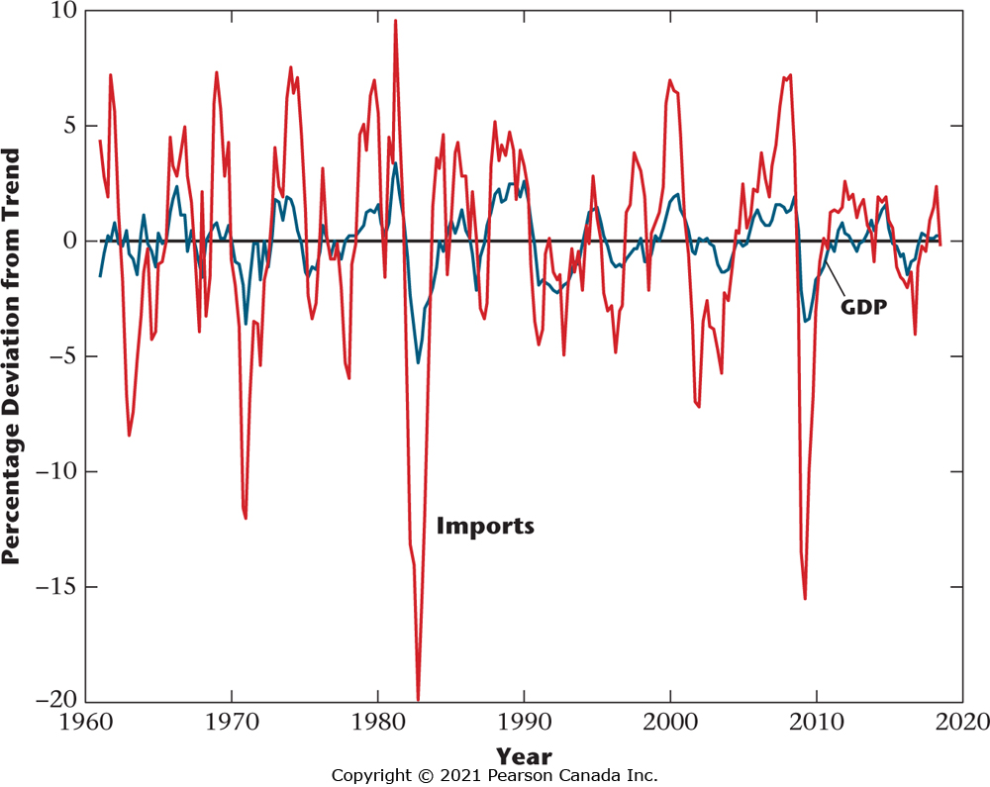
Figure 3.5 Imports and GDP for Canada, 1961–2018
This figure, as an example, shows the time series of percentage deviations from trend in real imports and real GDP for Canada for the period 1961–2018. Imports and GDP are clearly positively correlated, so imports are procyclical.

Slide 11
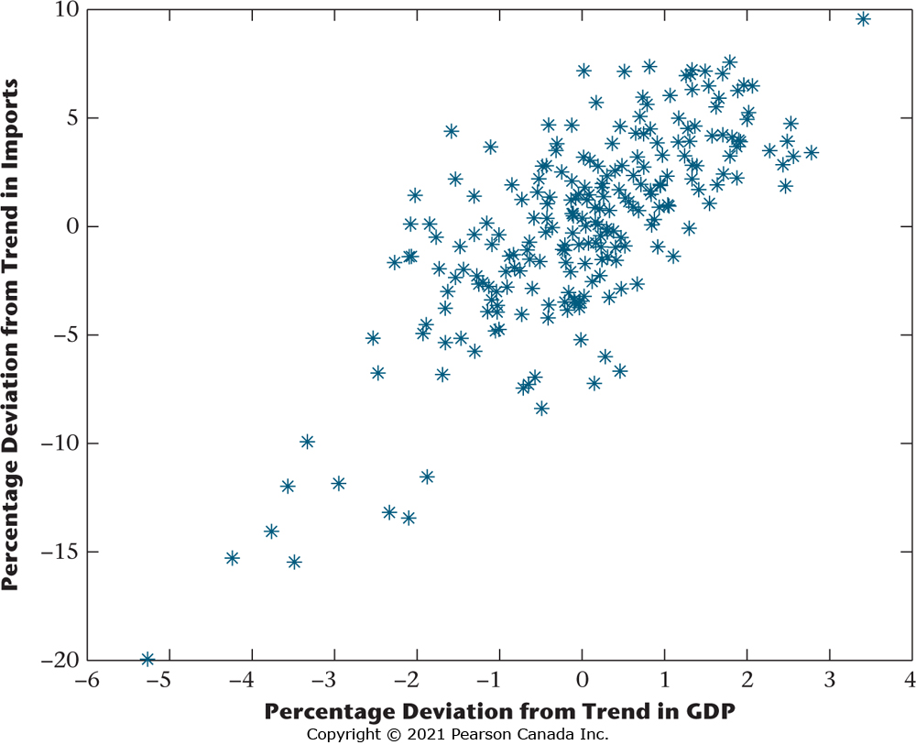
Figure 3.6 Scatter Plot of Imports and GDP for Canada, 1961–2018
This figure shows the same data as Figure 3.5 but in scatter plot rather than time series form. We again observe the positive correlation between imports and GDP, as a positively sloped straight line would best fit the scatter plot; and again, imports are procyclical.

Slide 12
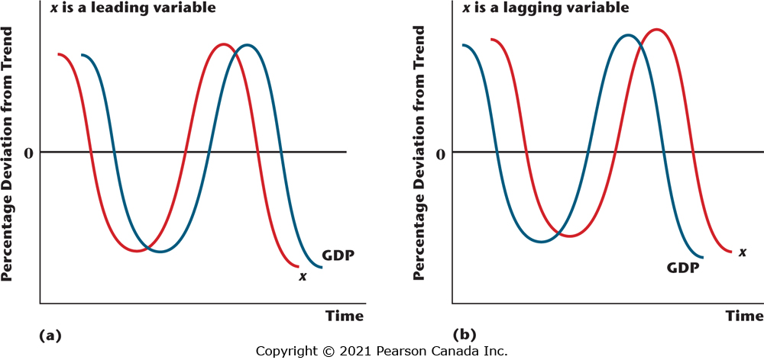
Figure 3.7 Leading and Lagging Variables
In (a) x is a leading variable, as its peaks and troughs tend to precede those of real GDP. In (b) x is a lagging variable, as the peaks and troughs in real GDP tend to lead those in x.

Slide 13
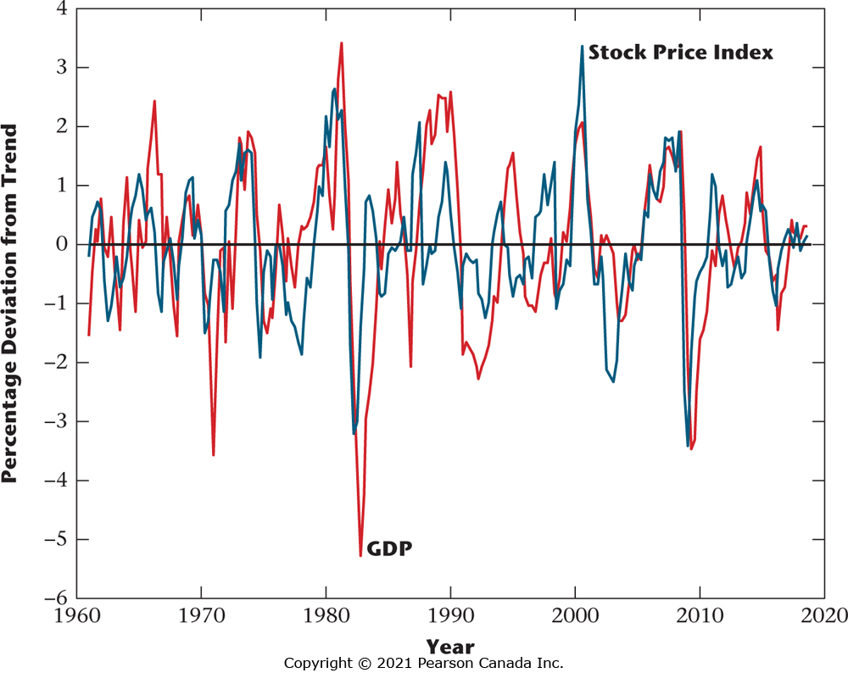
Figure 3.8 Percentage Deviations from Trend in Real GDP and the TSE Composite Index.
The stock index tends to lead real GDP.

Slide 14
Behavior of Key Macroeconomic Variables
If a macroeconomic variable tends to aid in predicting the future path of real GDP -> it is a leading variable; whereas if real GFP helps to predict the future path of a particular macroeconomic variable -> lagging variable
Correlation coefficient: Ameasure of the degree
Components of GDP: consumption and investment.
The price level and inflation.
Labour market variables: employment, real wage, average labour productivity.

Slide 15
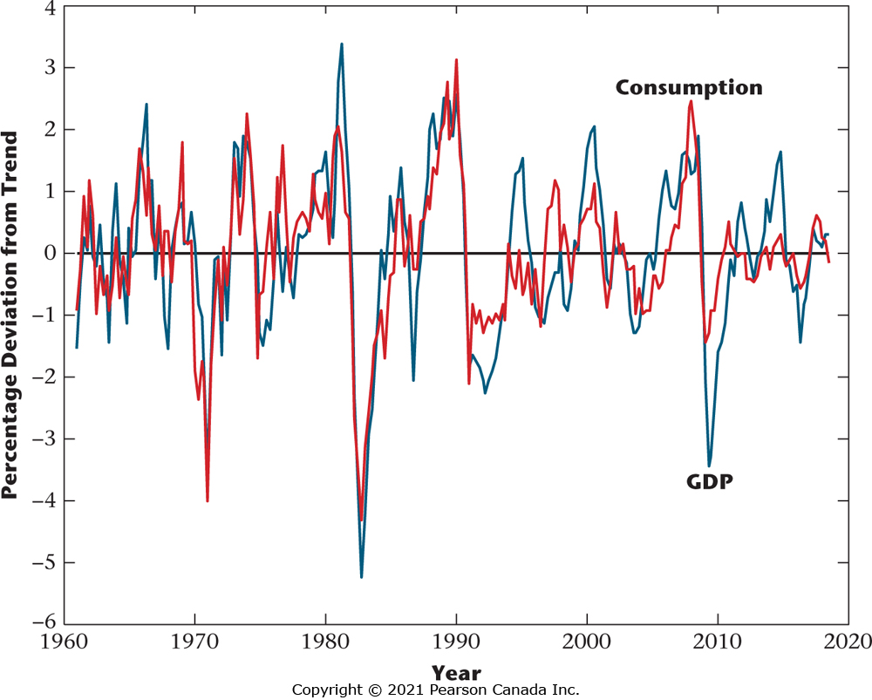
Figure 3.9 Percentage Deviations from Trend in Real Consumption and Real GDP for Canada, 1961–2018
From the figure, we can observe that consumption is procyclical, coincident, and less variable than GDP.

Slide 16
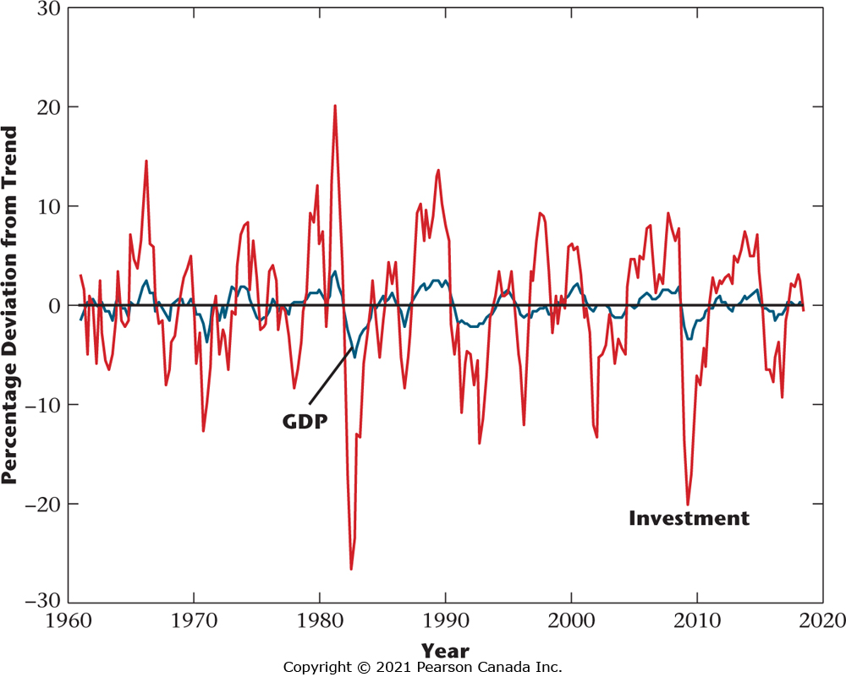
Figure 3.10 Percentage Deviations from Trend in Real Investment and Real GDP for Canada, 1961–2018
We can observe from the figure that investment is procyclical, coincident, and more variable than GDP.

Slide 17
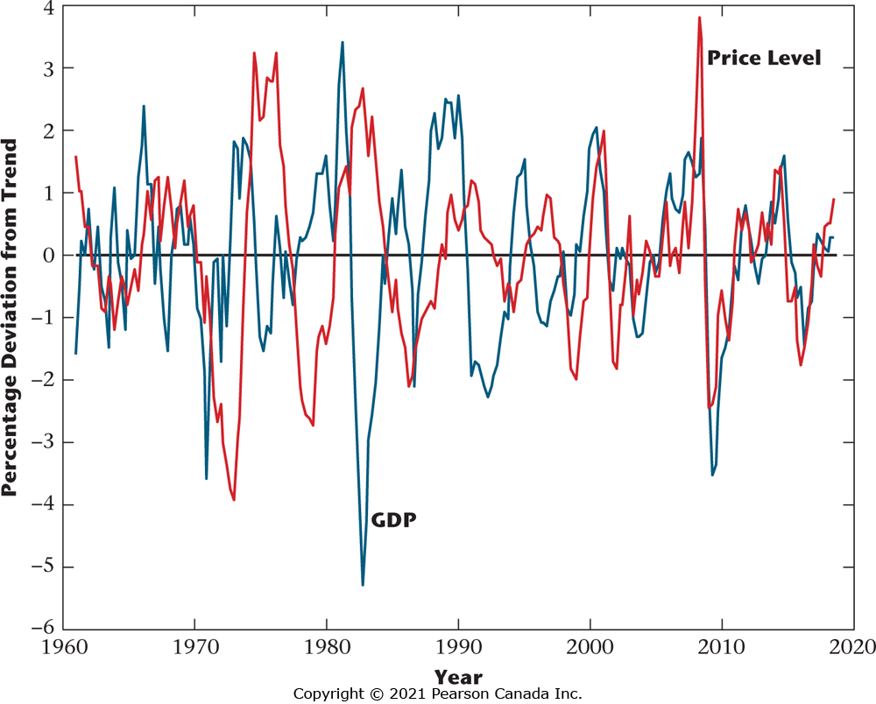
Figure 3.11 Percentage Deviations from Trend in the Price Level and Real GDP, 1961–2018
Philips curve:
Negative relationship between the rate of change in money wage and the unemployment rate
The figure shows essentially zero correlation. There is no discernible Phillips curve correlation.

Slide 18
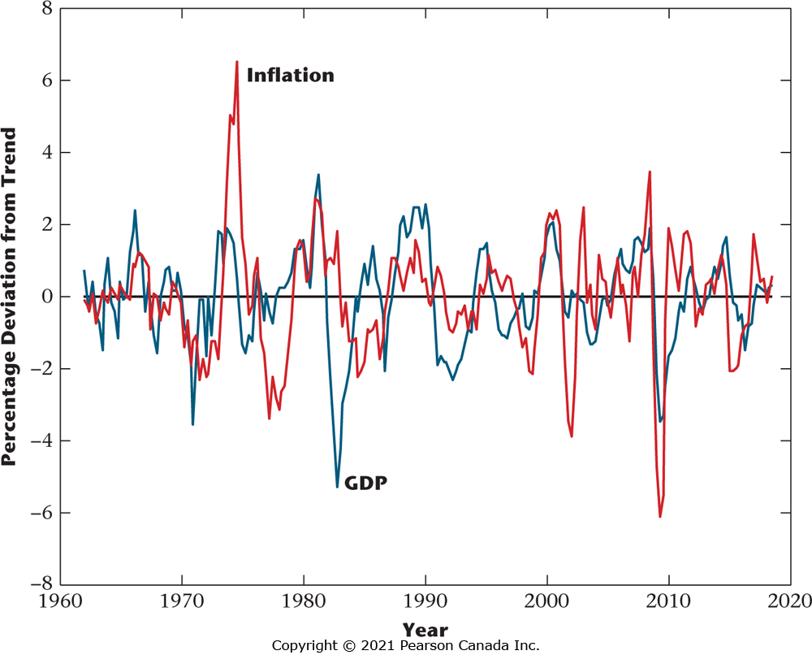
Figure 3.12 Percentage Deviation from Trend in Real GDP, and Deviation from Trend in the Inflation Rate, 1961–2018
The inflation rate and real GDP are positively correlated, consistent with traditional Phillips curve ideas.

Slide 19
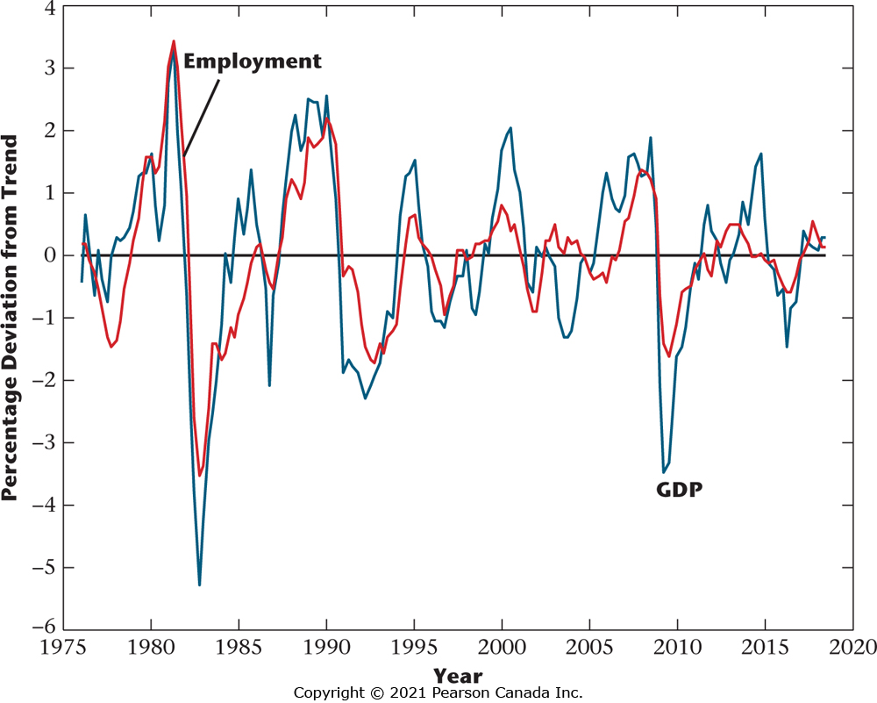
Figure 3.14 Percentage Deviations from Trend in Employment and Real GDP for Canada, 1976–2018
Employment is procyclical; it is a lagging variable; and it is less variable than real GDP.

Slide 20
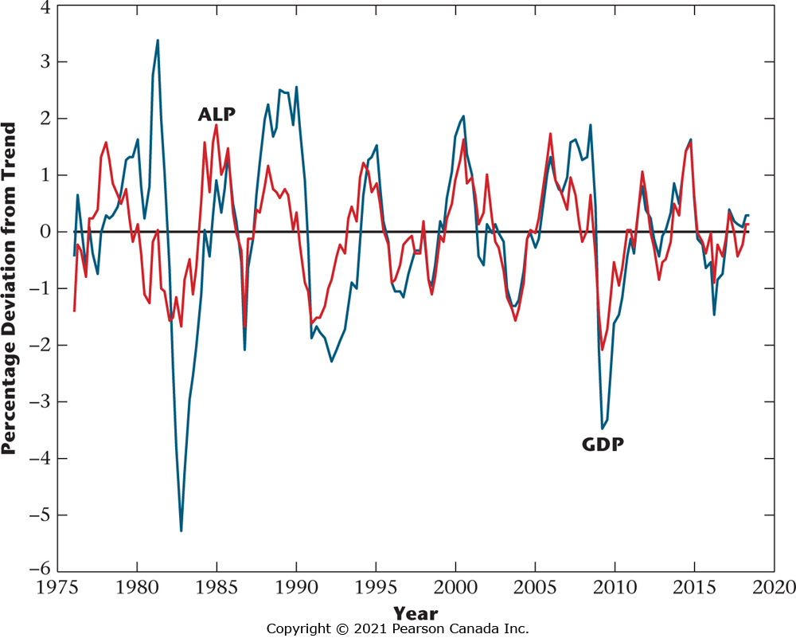
Figure 3.15 Percentage Deviations from Trend in Average Labour Productivity and Real GDP
Average labour productivity is procyclical and coincident, and it is less variable than real GDP.

Slide 21
Table 3.1 Correlation Coefficients and Variability of Percentage Deviations from Trend
 | Correlation Coefficient (GDP) | Std. Dev. (% of S.D. of GDP)
Consumption | 0.78 | 83%
Investment | 0.81 | 509
Employment | 0.79 | 80
Average labour productivity | 0.65 | 64

Slide 22
Table 3.2 Summary of Business Cycle Facts
 | Cyclicality | Lead/Lag | Variability Relative to GDP
Consumption | Procyclical | Coincident | Smaller
Investment | Procyclical | Coincident | Larger
Employment | Procyclical | Lagging | Smaller
Real wage rate | Procyclical | ? | ?
Average labour productivity | Procyclical | Coincident | Smaller

